Slide 1
Unit 10 Semantic Analysis

Slide 2
Summary
Semantics of programming languages
Symbol tables
Scope Rules and Symbol Tables
Translation Schemes for building Symbol Tables
Type checking
Type system
Specifying a Type Checker
Type Conversion

Slide 3
Semantic analysis
Extract types and other information from the program
Check language rules that go beyond the grammar
Assign storage locations
Construct symbol tables – For each identiﬁer in the program, record its attributes (kind, type, etc.)

Slide 4
Semantic analysis
Find errors after parsing
The type of the right-side expression of an assignment statement should match the type of the left-side, and the left-side needs to be a properly declared and assignable identiﬁer (i.e. not some sort of constant).
The parameters of a function should match the arguments of a function call in both number and type.
The language may require that identiﬁers are unique, disallowing a global variable and function of the same name.
The operands to multiplication operation will need to be of numeric type, perhaps even the exact same type depending on the strictness of the language
Parse trees are used in semantic analysis

Slide 5
Type checking
A compiler must check that the program follows the Type Rules of the language.
Information about Data Types is maintained and computed by the compiler.
The Type Checker is a module of a compiler devoted to type checking tasks.

Slide 6
Examples of Tasks
The operator modulus (%) is defined only if the operands are integers;
Indexing is allowed only on an array and the index must be an integer;
A function must have a precise number of arguments and the parameters must have a correct type;

Slide 7
Type checking
Type Checking may be either static or dynamic.
The one done at compile time is static.
In languages like Pascal and C type checking is primarily static and is used to check the correctness of a program before its execution.
Static type checking is also useful to determine the amount of memory needed to store variables.
The design of a Type Checker depends on the syntactic structure of language constructs, the Type Expressions of the language, and the rules for assigning types to constructs.

Slide 8
Type Expressions
A Type Expression denotes the type of a language construct.
A type expression is either a Basic Type or is built applying Type Constructors to other types.
A Basic Type is a type expression (int, real, boolean, char). The basic type void represents the empty set and allows statements to be checked;
Type expressions can be associated with a name: Type Names are type expressions;
A Type Constructor applied to type expressions is a type expression.

Slide 9
Type expresions (con’d)
Array. If T is a type expression, then array(I,T) is a type expression denoting an array with elements of type T and index range in I (e.g.,array[1..10] of int == array(1..10,int))
Cartesian Product If T₁and T₂ are type expressions, then their Cartesian Product T1× T2 is a type expression;
Record. Similar to Product but with names for different fields (used to access the components of a record).
Example of a C record type
struct
{
double r;
int i;
}

Slide 10
Type expressions (con’d)
Pointer. If T is a type expression, then pointer(T) is the type expression “pointer to an object of type T”
Function. If D is the domain and R the range of the function then wedenote its type by the type expression: D : R.
Example
The Pascal function:
function f(a, b: char): integer
has type: char × char : int.

Slide 11
Type System
Type System: Collection of rules for assigning type expressions to the various part of a program.
Type Systems are specified using syntax directed definitions.
A type checker implements a type system.
A language is strongly typed if its compiler can guarantee that the program it accepts will execute without type errors.

Slide 12
Specification of a Type Checker
We specify a type checker for a simple language where identifiers have an associated type.
Attribute Grammar for Declarations and Expressions:
P → D;E
D → D;D | id : T
T → char | int | array[num] of T | ↑T
E → literal | num | id | E mod E | E[E] | E↑

Slide 13
Syntax-Directed Translation
Technique used to build semantic information for large structures, based on its syntax.
In a compiler, Syntax-Directed Translation is used for
Constructing Abstract Syntax Tree
Type checking
Intermediate code generation
The semantics (i.e., meaning) of the various constructs in the language is viewed as attributes of the corresponding grammar symbols.
Attributes are associated with Terminal as well as Nonterminal symbols

Slide 14
Attributes
Synthesized attribute: An attribute that gets its values from the attributes attached to the children of its nonterminal.
Value flows from child to parent in the parse tree.
Example: val in Expression grammar
Inherited attribute: An attribute that gets its values from the attributes attached to the parent (or siblings) of its nonterminal.
Value flows into a node in the parse tree from parents and/or siblings.
Example: type of VarList in declaration grammar

Slide 15
Syntax Directed Definition
Syntax Directed Definitions are a generalization of context-free grammars in which:
1. Grammar symbols have an associated set of Attributes;
2. Productions are associated with Semantic Rules for computing the values of attributes.
Such formalism generates Annotated Parse-Trees where each node of the tree is a record with a field for each attribute (e.g., X.a indicates the attribute a of the grammar symbol X).

Slide 16
Forms of a syntax directed definition
A grammar production Y --> X₁ … X_{n} may have zero or more associated semantic rules. Each semantic rules has the form, b = f(c₁,…,c_{k}) are attributes of the grammar symbol in the production such that:
1. b is a synthesized attribute and c₁,…,c_{k} are the attributes of the grammar symbols on the rhs or
2. b is an inherited attribute of one of the RHS grammar symbols and c₁,…,c_{k} are any other attributes in the production.
If the function f does not have side effects, syntax directed definitions is also called as attribute grammars.

Slide 17
Example
Production | Semantic rules
L → E return | Print (E.val)
E → E₁+T | E.val = E1.val + T.val
E → T | E.val = T.val
T → T₁ * F | T.val = T1.val * F.val
T → F | T.val = F.val
F → (E) | F.val = E.val
F → num | F.val = num.Lexval
Consider the Grammar for arithmetic expressions above. The Syntax Directed Definition associates to each non terminal a synthesized an attribute called val.

Slide 18
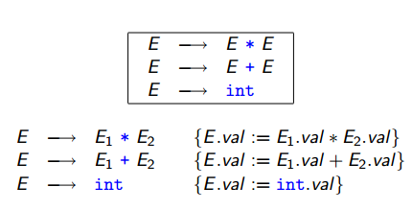
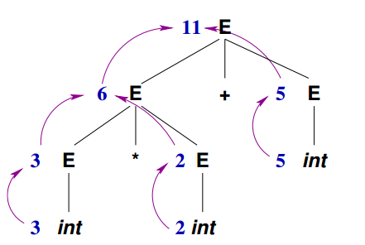
Synthesized Attribute Example
Information Flow for 3*2+5

Slide 19
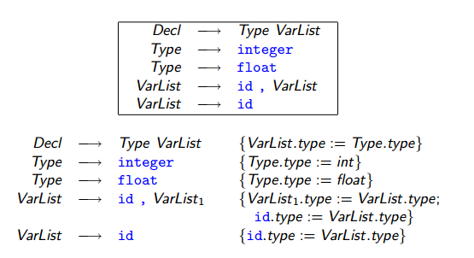
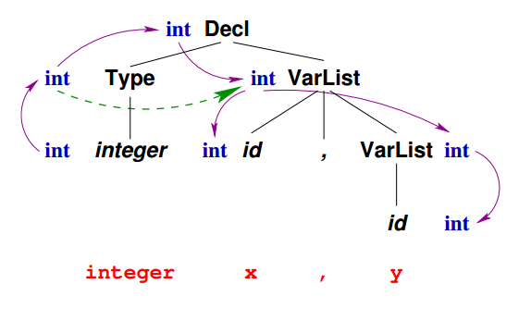
Inherited Attribute Example

Slide 20
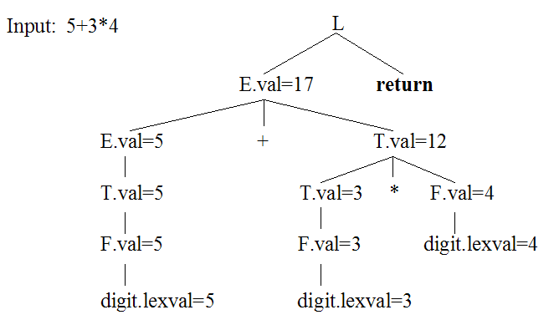
Example of annotated parse tree

Slide 21
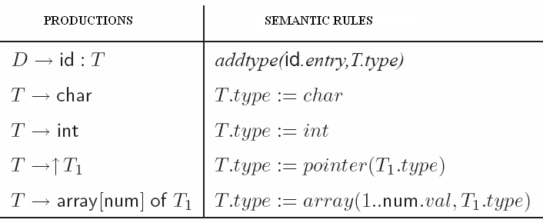
Type checker of identifiers

Slide 22
Insert type of variable to symbol table
do {// code in compileVardecl function
eat(TK_IDENT);
checkFreshIdent(currentToken->string);
varObj = createVariableObject(currentToken->string);
eat(SB_COLON);
varType = compileType();
varObj->varAttrs->type = varType;
declareObject(varObj);
eat(SB_SEMICOLON);
} while (lookAhead->tokenType == TK_IDENT);
//data type is returned by function compileType in the next slide.

Slide 23
arraySize = currentToken->value;
eat(SB_RSEL);
eat(KW_OF);
elementType = compileType();
type = makeArrayType(arraySize, elementType);
break;
case TK_IDENT:
eat(TK_IDENT);
obj = checkDeclaredType(currentToken->string);
type = duplicateType(obj->typeAttrs->actualType);
break;
default:
error(ERR_INVALID_TYPE, lookAhead->lineNo, lookAhead->colNo);
break;
}
return type;}
Type* compileType(void) {
Type* type;
Type* elementType;
int arraySize;
Object* obj;
switch (lookAhead->tokenType) {
case KW_INTEGER:
eat(KW_INTEGER);
type = makeIntType();
break;
case KW_CHAR:
eat(KW_CHAR);
type = makeCharType();
break;
case KW_ARRAY:
eat(KW_ARRAY);
eat(SB_LSEL);
eat(TK_NUMBER);

Slide 24
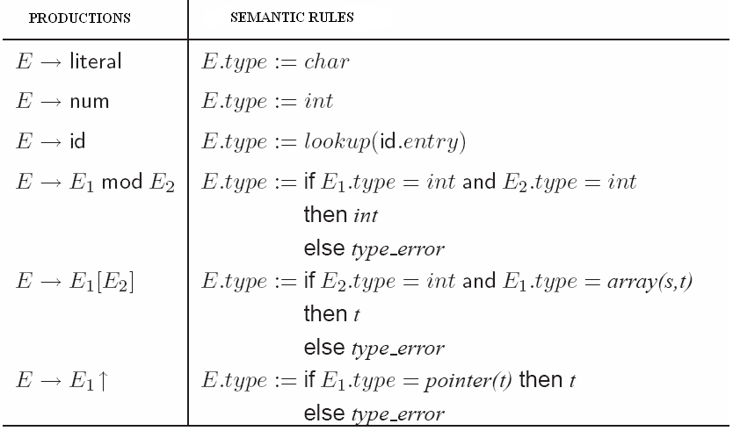
Type checker of expressions

Slide 25
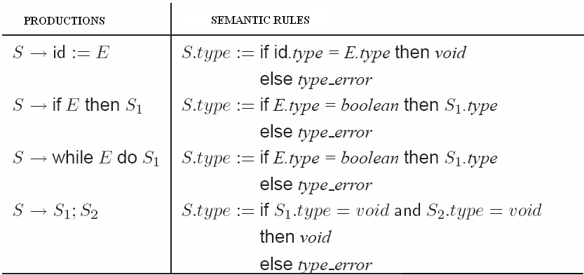
Type checker of statements

Slide 26
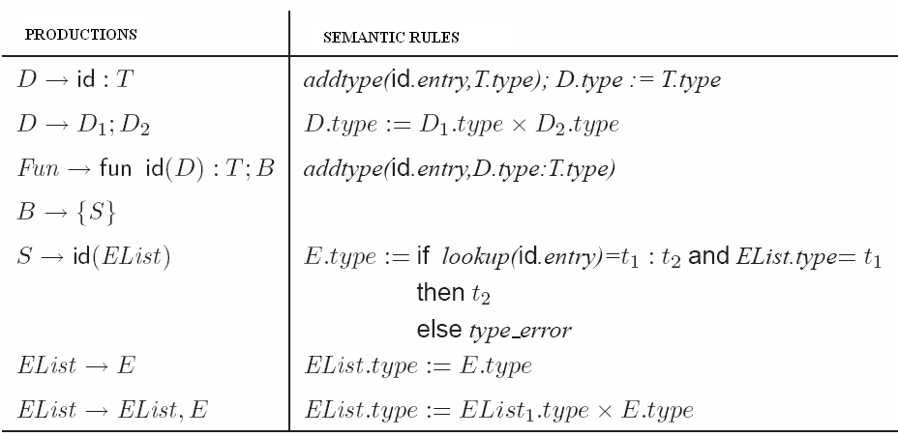
Type checker of functions

Slide 27
Function for checking equivalence of types
function sequiv(s, t): boolean;
begin
if s and t have the same basic type then
return true;
else if s = array(s1, s2) and t = array(t1, t2) then
return sequiv(s1, t1) and sequiv(s2, t2)
else if s = s1 x s2 and t = t1 x t2) then
return sequiv(s1, t1) and sequiv(s2, t2)
else if s = pointer(s1) and t = pointer(t1) then
return sequiv(s1, t1)
else if s = s1→ s2 and t = t1→ t2 then
return sequiv(s1, t1) and sequiv(s2, t2)
else
return false;
end;

Slide 28
Type Conversion
What’s the type of “x + i” if:
1. x is of type real;
2. i is of type int;
3. Different machine instructions are used for operations on reals and integers.
Depending on the language, specific conversion rules must be adopted by the compiler to convert the type of one of the operand of +.
The type checker in a compiler can insert these conversion operators into the intermediate code.
Such an implicit type conversion is called Coercion.

Slide 29
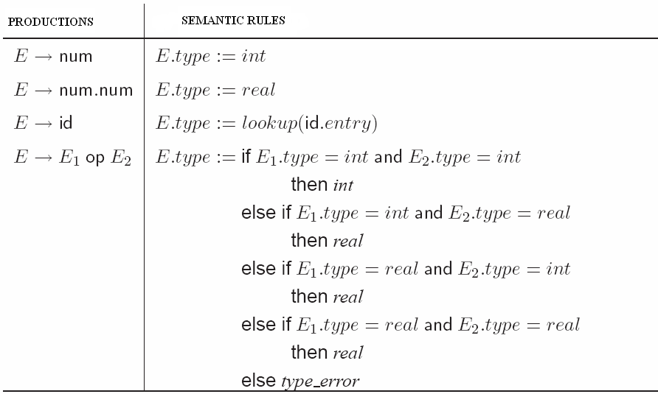
Type coercion rules

Slide 30
Symbol Table
The Symbol Table is the major inherited attribute and the major data structure as well.
Symbol Tables store information about the name, type, scope and allocation size.
Symbol Table must maintain efficiency against insertion and lookup.
Dynamic data structures must be used to implement a symbol table: Linear Lists and Hash Tables are the most used.
Each entry has the form of a record with a field for each peace of information.

Slide 31
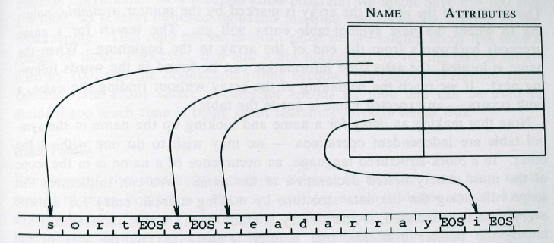
Storing names

Slide 32
Symbol Tables and Scope Rules
A Block in a programming language is any set of language constructs that can contain declarations.
A language is Block Structured if
1. Blocks can be nested inside other blocks, and
2. The Scope of declarations in a block is limited to that block and the blocks contained in that block.
Most Closely Nested Rule. Given several different declarations for the same identifier, the declaration that applies is the one in the most closely nested block.

Slide 33
Symbol Tables and Scope Rules (con’d)
To implement symbol tables complying with nested scopes
1. The insert operation into the symbol table must not overwrite previous declarations;
2. The lookup operation into the symbol table must always refer to the most close block rule;
3. The delete operation must delete only the most recent declarations.
The symbol table behaves in a stack-like manner.

Slide 34
Procedure Activations: Example
program sort;
var a : array[0..10] of integer;
x : integer;
procedure readarray;
var i : integer;
begin … a … end { readarray };
procedure exchange( i:integer; j : integer );
begin
x := a[i]; a[i] := a[j]; a[j] := x
end { exchange };
procedure quicksort( m: integer; n: integer );
var k, v : integer;
function partition( y:integer; z: integer ): integer;
var i, j : integer;
begin… a …
… v …
… exchange( i, j ); …
end { partition };
begin … end { quicksort };
begin … end { sort };

Slide 35
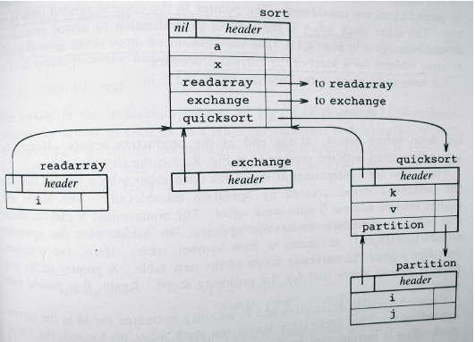
Maintain separate symbol tables for each scope
Tables must be linked both from inner to outer scope, and from outer to inner

Slide 36
Lexical- Vs. Syntactic-Time Construction
Information is first entered into a symbol table by the lexical analyzer only if the programming language does not allow for different declarations for the same identifier (scope).
If scoping is allowed, the lexical analyzer will only return the name of the identifier together with the token
The identifier is inserted into the symbol table when the syntactic role played by the identifier is discovered.

Slide 37
Relative Address
Relative Address. Is a storage allocation information consisting of an offset from a base (usually zero) address: The Loader will be responsible for the run-time storage.

Slide 38
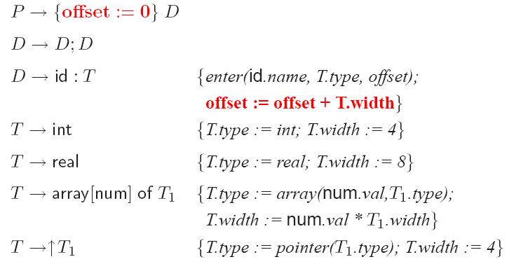
Computes relative address
Use a global variable called offset.

Slide 39
Computes relative address
The global variable offset keeps track of the next available address.
Before the first declaration, offset is set to 0
As each new identifier is seen it is entered in the symbol table and offset is incremented.
type and width are synthesized attributes for non-terminal T.

Slide 40
Keeping Track of Scope Information
Consider Nested Procedures: When a nested procedure is seen processing of declarations in the enclosing procedure is suspended.
To keep track of nesting a stack is maintained.
We associate a new symbol table for each procedure:
When we need to enter a new identifier into a symbol table we need to specify which symbol table to use.

Slide 41
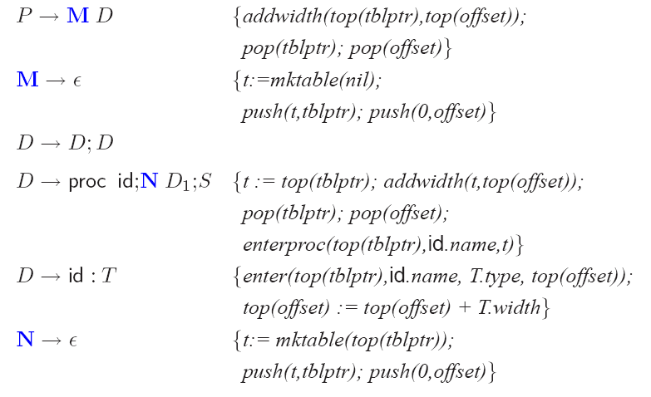
Processing declarations in nested procedures

Slide 42
Keeping Track of Scope Information
The semantic rules make use of the following procedures and stack variables:
1. mktable(previous) creates a new symbol table and returns its pointer. The argument previous is the pointer to the enclosing procedure.
2. The stack tblptr holds pointers to symbol tables of the enclosing procedures.
3. The stack offset keeps track of the relative address w.r.t. a given nesting level.
4. enter(table,name,type,offset) creates a new entry for the identifier name in the symbol table pointed to by table, specifying its type and offset.
5. addwidth(table,width) records the cumulative width of all the entries in table in the header of the symbol table.
6. enterproc(table,name,newtable) creates a new entry for procedure name inthe symbol table pointed to by table. The argument newtable points to the symbol table for this procedure name.

